Slide 1
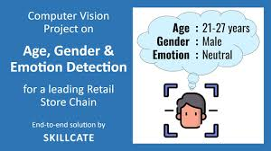
Team- Ai Visioners Emotion age and gender detection
Subject-CSET301(AIML)
Professor-Dr.Tarandeep Singh

Slide 2
Why need For this ?
Increasing demand for AI in real-time human behavior analysis.
Helps in tailoring user experiences based on emotional and demographic data.
Useful in surveillance, healthcare, education, and marketing industries.
Enhances human-computer interaction with more personalized responses.
Can support mental health monitoring by detecting distress through facial cues.

Slide 3
Our Mission with This Project
Develop an AI-based system capable of predicting age, gender, and emotion from a
single face scan.
Combine deep learning with computer vision for accurate and real-time predictions.
Create a low-cost, accessible solution for educational and practical applications.
Ensure the model is robust enough for diverse faces and environments.

Slide 4
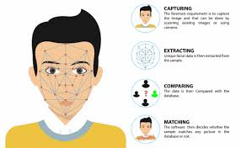
How It Works
Extracted face is preprocessed (grayscale, resized to 48x48 pixels).
Three separate CNN models are used for predicting age, gender, and emotion.
Real-time results are displayed with bounding boxes and prediction labels.
All processing is done locally, ensuring quick response time.
Uses OpenCV to capture video and detect faces.

Slide 5
Difficulties During Development
Integrating multiple models efficiently without performance lag.
Model compatibility issues with input dimensions (RGB vs grayscale).
Handling varying lighting conditions and face orientations in real-time.
Ensuring predictions are accurate across different age groups and ethnicities.
Deprecation warnings and API changes in TensorFlow and Keras.

Slide 6
Next Step for This Project in Future
Combine all three models into one optimized, multitask CNN.
Deploy the system on edge devices (like Raspberry Pi with a camera).
Train on larger, more diverse datasets for higher accuracy.
Add voice-based emotion recognition for multimodal analysis.
Develop a user-friendly GUI or web app for wider accessibility.

Slide 7
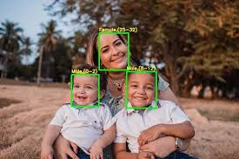
THANK YOU
Team Members
Dhaarna Goyal- E23CSEU0106
Hiyaa- E23CSEU0120
Ujjwal Saini - E23CSEU0102

